Slide 1
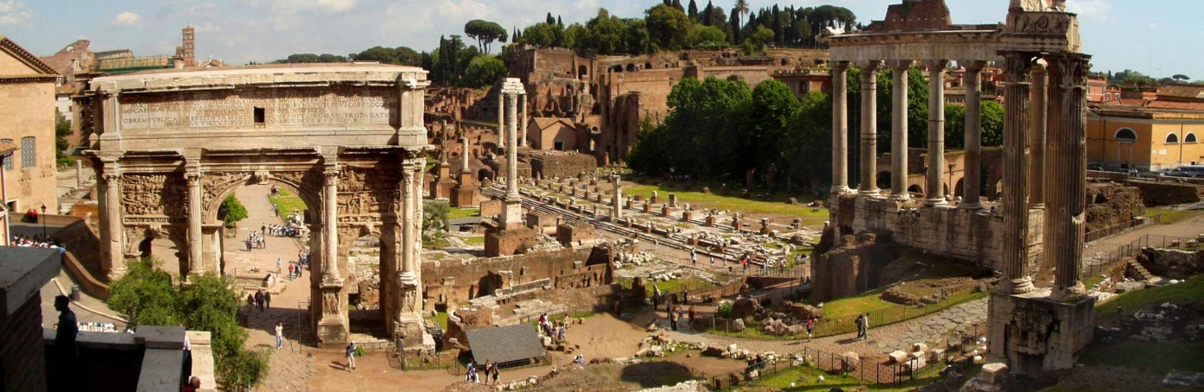
Rome :The Rise to Empire

Slide 2
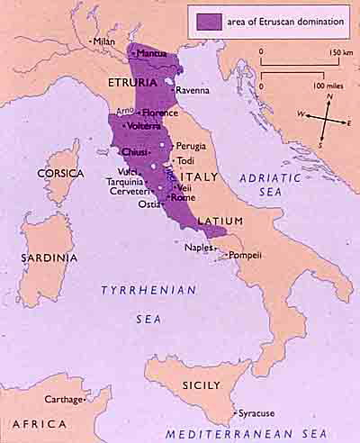

Slide 3
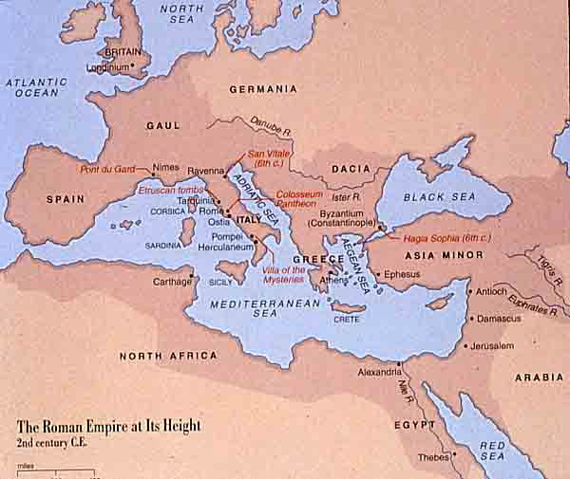

Slide 4
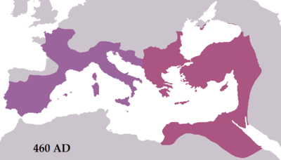

Slide 5
Rome’s Early History
Rome’s origins are found among the tribes of the Iron Age called Etruscans, who invaded the Italian peninsula just after the first millennium B.C.E. and ruled as kings.
By mid-eighth century B.C.E., the various established people of the area rebelled against the Etruscans and founded the city of Rome in the lower valley of the Tiber river. This new settlement was infused with other Mediterranean peoples from surrounding areas like the Latins, the Greeks, and the Phoenicians; and the new Romans borrowed elements from each to enhance their own history.
From the Etruscans, the Romans absorbed the fundamentals of urban planning, chariot racing, the toga, bronze and gold crafting, and a principal structure of Mesopotamian architecture-the arch.
From the Greeks, the Romans borrowed a bevy of gods and goddesses, linguistic and literary principals, and the aesthetics of the Classical style.
In absorbing the best elements each set of people in the surrounding areas, the Romans would create the most powerful world-state in ancient history. What has the United States borrowed from other cultures?

Slide 6
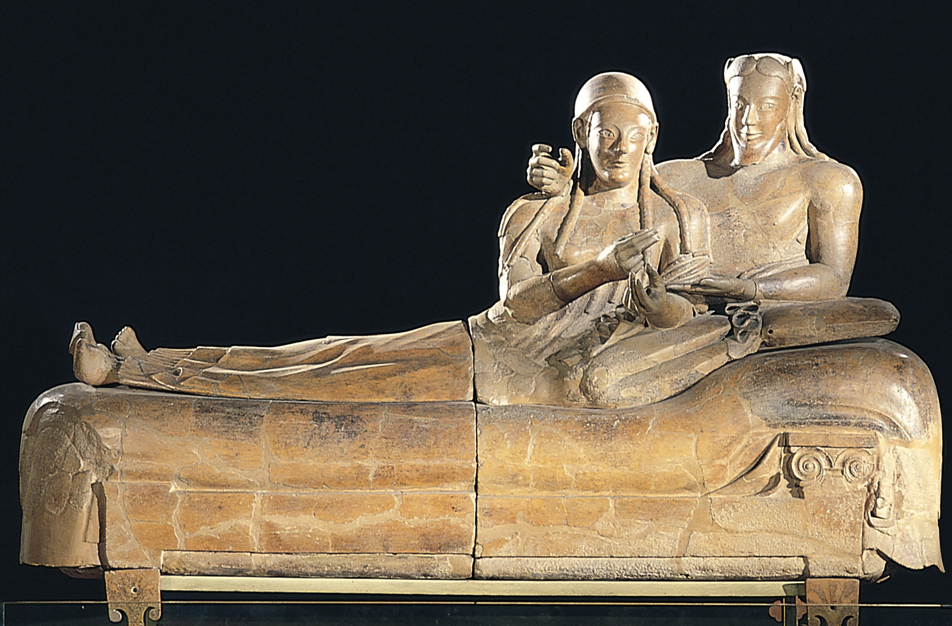
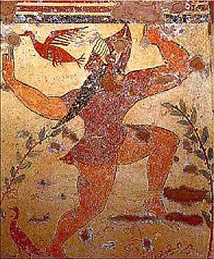
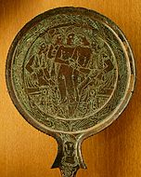
Etruscan Art:
Before the emergence of the Romans, Italy was dominated by the Etruscans, a people who appear in historical record around the eighth century B.C.E.
Their trading links brought them into contact with many cultures, but their art was chiefly influenced by the Greeks.
The Etruscans were concerned with the preservation of the body and the afterlife, and they developed an elaborate cult of the dead. They created huge necropolises and staged funeral games-a precursor to the gladiator games in Rome.
The Etruscans were also noted for their tomb sculpture and high quality metalwork. The latter includes some remarkable bronze mirrors, decorated with mythological scenes, highlighting the benefits of physical beauty.

Slide 7
The Roman Republic (509-133 B.C.E.)
After the Etruscans were overthrown, the existing monarchy gave way to a government “of the people” (res publica). Done away with were the kings, and in their place the elected consul was created.
The agricultural population of ancient Rome consisted of a powerful class of large landowners called patricians. This wealthy upper class were life members of the Roman Senate and controlled the lawmaking process.
The remaining population of Rome was made up of a more populous class of farmers and small landowners called plebeians. The plebeians constituted the membership of Popular Assembly, which had a fairly small voice initially. However, through their service as soldiers in the Roman army they made themselves heard, eventually winning the freedom to intermarry with patricians, the right to hold executive office, and, finally, in 287 B.C.E., the privilege of making laws.
Despite the difficulties arising from governing far off territories, (the Empire’s reach included most of North Africa, Greece, Egypt, and much of Southwest Asia), the Roman’s were efficient administrators. They demanded taxes, service in the Roman army, and slaves from their foreign provinces.
The Roman’s brought the Latin language and Roman law to the provinces. They built paved roads, fresh water aqueducts, bridges, and eventually granted the people of their conquered territories Roman citizenship.

Slide 8
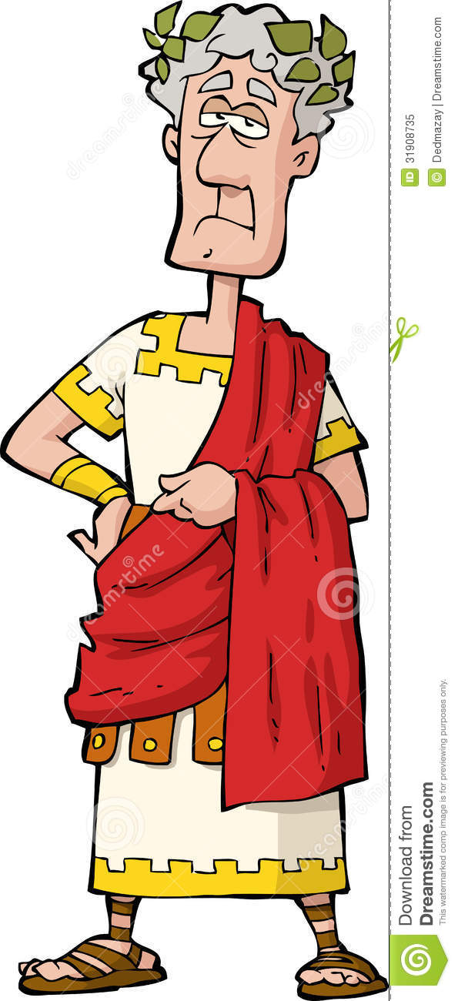
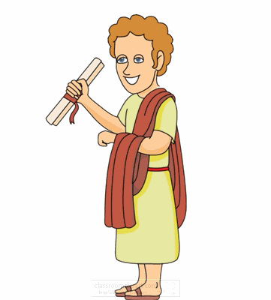
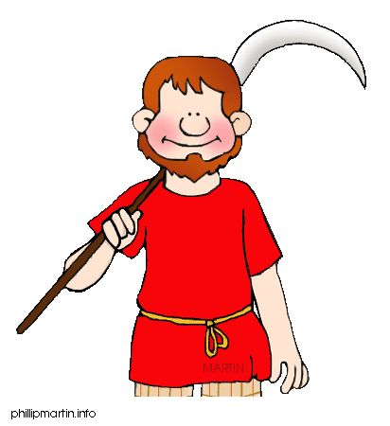
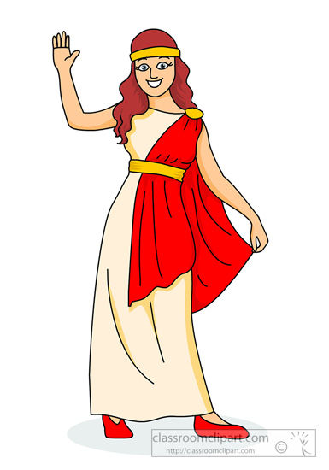
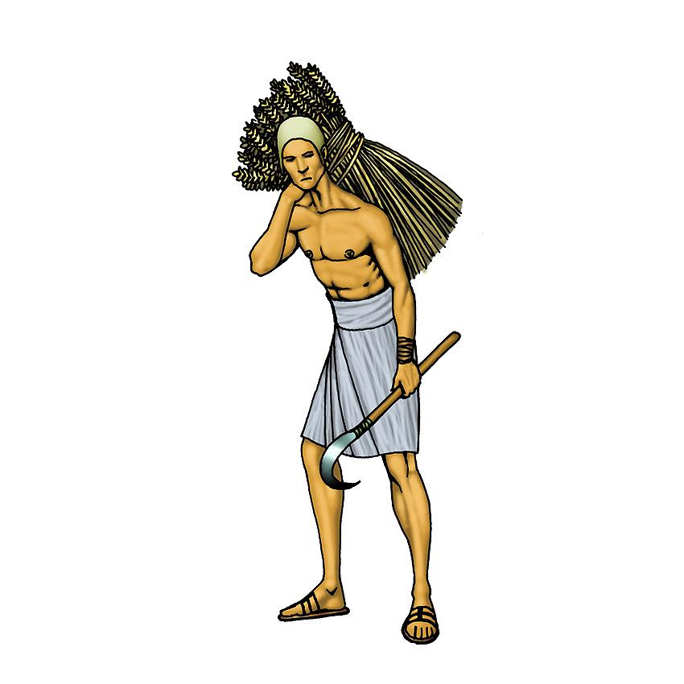
Roman Class Divisions:
Patrician
Plebeian
Freedman
Women
Slave

Slide 9

The Laurel Wreath
Made from the leaves and branches of a laurel tree.
Used to show religious, political, and military significance in ancient Roman society.
Emperors and gods are depicted in art wearing laurel wreaths.
Romans used many types of wreaths to show important life achievements or status changes, but the laurel wreath was reserved for the gods and most prestigious members of society.

Slide 10
After discussing the attributes of Rome as the most powerful world-state in ancient history, what do you think would lead to it’s downfall a mere 400 years later?

Slide 11
The Collapse of the Republic (133-30 B.C.E.)
Even with an all-powerful Senate, an envied army, and massive wealth brought on by foreign conquests, corruption became widespread.
The increased agricultural productivity of the latifundia, or large Roman farm maintained by slaves, gave economic advantage to large landowners who easily undersold the lesser landowners an drove them out of business. The small landowners were forced to sell their farms to neighborhood patricians remaining on the land, or they moved to the city and joined the growing unemployed population.
With corruption running a tight second, the disappearance of the small farmer signaled the decline of the Republic, and as the rich got richer and more corrupt, the military forces and patricians turned on each other, creating civil war, and the Republic crumbled.
Enter Julius Caesar in 48 B.C.E., who expanded the empire substantially and created a dictatorship in the city of Rome. A suburb organizer, Caesar codified the laws, regulated taxation, reduced debts, sent unemployed plebeians to overseas colonies, and created public works projects. He was given the office for life in 44 BCE. Worried conspirators that thought he desired to be king, murdered Caesar on the Ides of March (March 14), just before a Senate session. Caesar attempted to flee his attackers, but he tripped and fell, laying defenseless.

Slide 12


TRIUMVIRATE
A government by three people with equal power;
From TRI (three) and VIRATE (of men)
LEPIDUS
OCTAVIAN
CAESAR
CRASSUS
POMPEY
MARK ANTONY

Slide 13
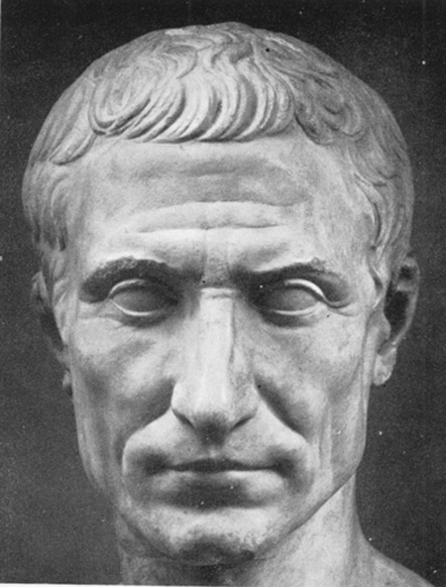
Julius Caesar
Caesar revamped Rome’s first urban center, the Forum, to a public meeting place that combined the functions of government, law, commerce, and religion.
He reformed the Western calendar to be comprised of 365 days and twelve months.
One of first historical Romans to be deified by the Roman Senate. Conferred posthumously in 42 B.C.E., the appearance of a comet during the games in Caesar's honor confirmed the appointment.
Many historians believe Caesar suffered from epilepsy.
Caesar was considered one of Rome’s best orators and authors of Latin prose.

Slide 14
The Pax Romana “Roman Peace”(30 B.C.E.-180 C.E.)
Following the assassination of Julius Caesar, a political struggle ensued between Caesar’s first lieutenant, Mark Anthony, and his grandnephew Octavian. Although Anthony, along with Egypt’s most seductive queen, Cleopatra, put up a large military offensive to attempt to gain control of Rome’ s empire, in 43 B.C.E., Octavian usurped the consulship and gained approval of the Senate to rule for life.
The Senate gave Octavian the name Augustus, or “the Revered One.” Augustus shared legislative power with the Senate, but retained the ability to veto legislation. Rome was again in the hands of a military dictator, or what is known in history as the first Roman emperor.
An enthusiastic patron of the arts, Augustus commissioned literature, sculpture, and architecture, boasting that Rome was a city made of brick when he took power, and he would leave it a city made of marble. Augustus was very anti-Hellenistic…interesting considering how attached he was to the Greek-created art.
Augustus initiated many new public works such as three aqueducts and as many as 500 fountains, and civic services like a police and fire department. The reign of Augustus also witnessed the birth of Christianity, which would spread throughout the Empire.
Augustus died at the age of 75, either by natural causes, or by poisoning at the hands of his wife, Livia.

Slide 15
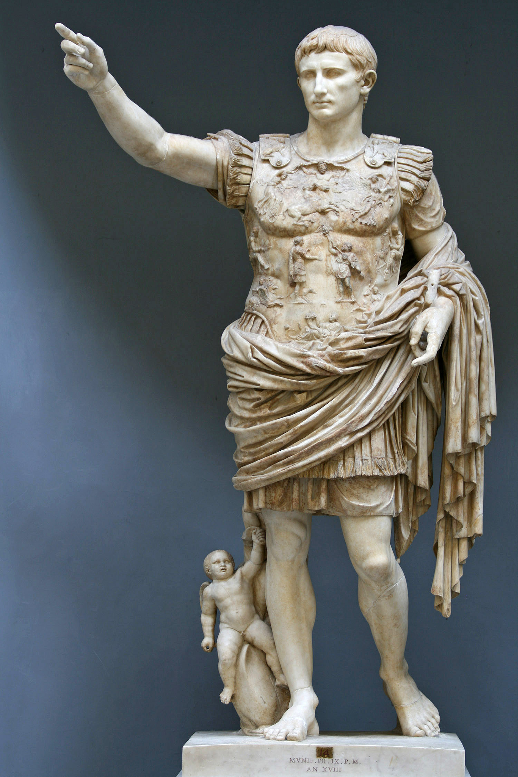
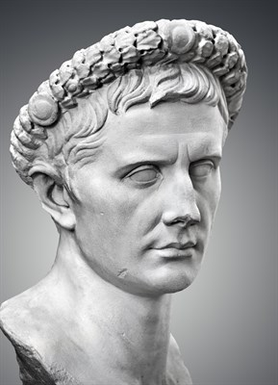
Augustus

Slide 16
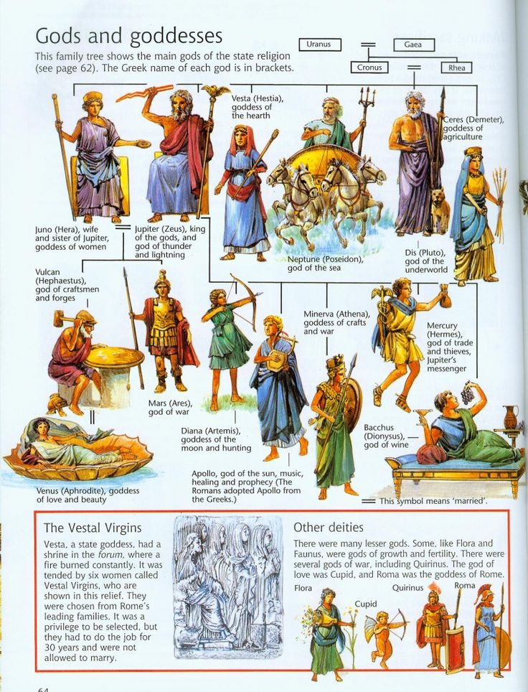
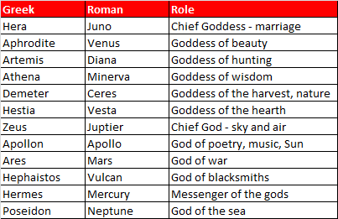
Greek Gods Verses Roman Gods

Slide 17
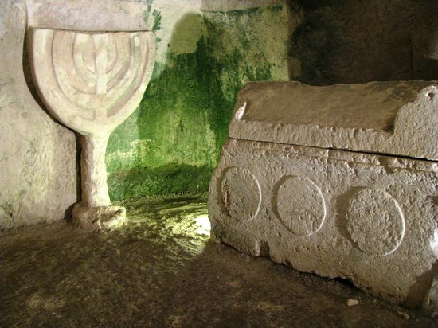
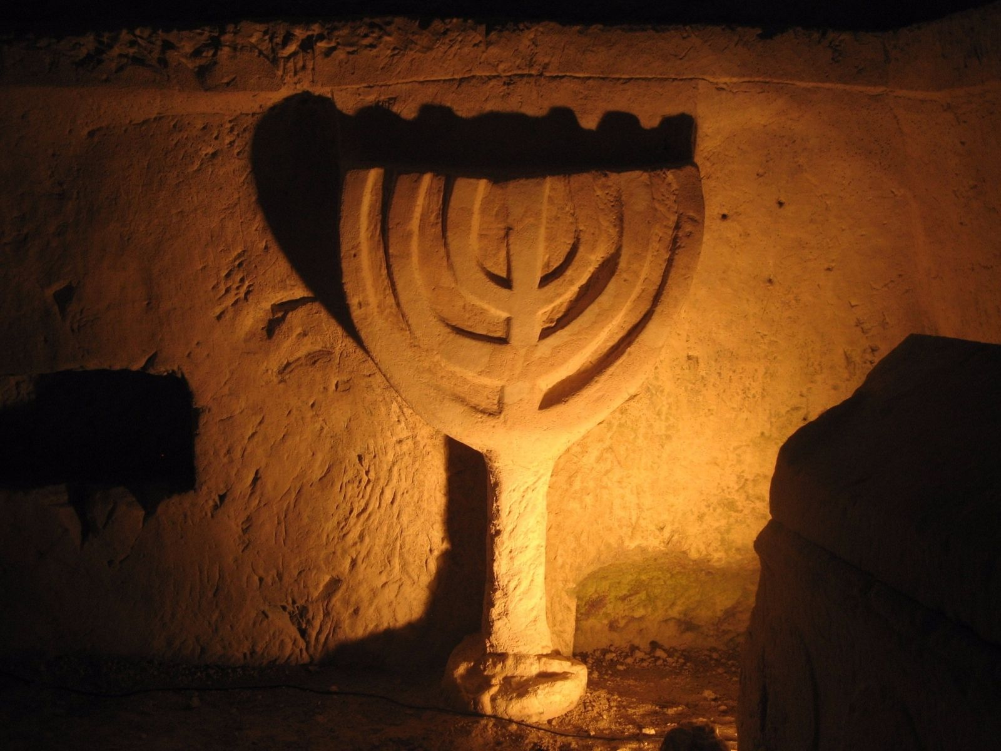
The Jews Under Rome:
Besides Christianity, the only major religion to survive the impact of Roman domination was Judaism. Scattered in settlements throughout the Empire, and surrounded by pagans, the Jews clung to their belief in one God, and to the literature, laws and language which had united then as a people for some 1,300 years.
Although they lived under chronic suspicion for their strict adherence to a monotheistic God, the Jews of Rome enjoyed periods of genuine toleration. Augustus even decreed that synagogues were inviolable and that Jews were exempt from appearing in court on the Sabbath.
Palestine, however, was a Jewish state which had been ruled by the Romans since 63 B.C.E. seething under the supervision of unpopular leaders, the Jews rose up in fierce rebellion in 66 A.D.
Other revolts followed but in 135 A.D. the Jews were driven out of Jerusalem and forbidden to re-enter; an exile that was to last until the 20th century.

Slide 18
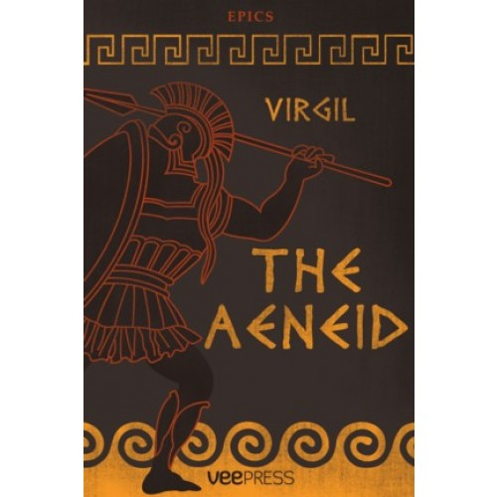
Epic Poetry
Rome enjoyed a golden age of Latin literature whose most notable contributor being Virgil (Publius Vergilius Maro).
Rome’s foremost poet-publicist, Virgil wrote the epic that immortalized Rome’s destiny as world ruler.
The Aeneid was not the product of an oral tradition, as in the Homeric epics; rather it is a literary epic. Virgil worked on this epic for ten years, and after falling ill on a trip to Greece, he died leaving the epic unfinished. Virgil requested prior to his death that if anything should happen to him the manuscript should be destroyed, however, Augustus would not see it destroyed and had it published anyway.
The first six books of the Aeneid recounts the voyage of Rome’s mythical founder, Aeneas, from Troy to Italy, and his love affair with the Carthaginian princess, Dido. The second six books describe the Trojan conquest of Latium and the establishment of the Roman state.
Virgil’s masterwork would become the foundation for education in the Latin language.

Slide 19
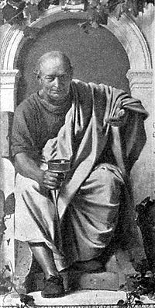
The Poems of Horace
Octavian’s poet laureate, Quintus Haeredes Flaccus, better known as Horace, took a critical view of life.
Horace composed verse that pointed out the contradictions between practical realities and philosophic ideals.
Having lived through the devastating civil wars of the first century B.C.E., Horace brought a commonsense insight to the subject of war.
Horace also was well-versed in the Roman genre of satire, a literary field that uses humor to denounce human vice and folly, where human perfection is not simplified criticized, but rather mocked through wit and comic exaggeration.
In Horace’s piece, To Be Quite Frank, he vividly describes a middle-aged woman with teenage pretensions. Still relevant now? Cougars anyone?

Slide 20
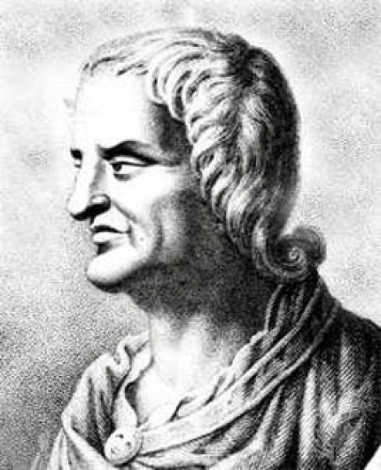
The Satires of Juvenal
Considered the most famous satirist to come out of Rome, Juvenal’s career as a magistrate and his experience of poverty and financial failure contributed to his negative perception of Roman society.
Describing the city of Rome as swollen with greed and corruption in his sixteen bitter Satires, Juvenal’s attack on he city of Rome paints a picture of a noisy, dirty, and crowded urban community inhabited by selfish, violent, an self-indulging people.
Juvenal was equally hostile toward foreigners and women. His sixth Satire, “Against Women,” is one of the most bitter anti-female diatribes in the history of Western literature. Here the poet laments the disappearance of the chaste Latin women whose virtues have been corrupted by luxury.
Do you have a favorite modern user of satire?

Slide 21
Roman Architecture
Rome’s architecture reflected the practical needs of a sprawling empire whose urban centers suffered from the congestion, noise, and filth described by Juvenal.
To link the provinces ranging from the Atlantic Ocean to the Euphrates River, Roman engineers built 50,000 miles of paved roads, many which are still in use today.
Eight and nine-story tenements provided thousands with cheap housing, Roman bridges and tunnels defied natural barriers, while some eighteen aqueducts brought over 40 million gallons of fresh water a day to Rome’s major cities.
Suburb engineers, the Roman’s employed the structural advantages of the arch to enclose great volumes of uninterrupted space. The arch constituted a clear technical advance over the post-and-lintel construction used by the Greeks.
Roman building techniques reveal a combination of practicality and innovation. The Romans were the first to use concrete, a medium that made possible cheap large-scale construction.
One of Rome’s most spectacular large-scale engineering projects involving arches is the 900-foot long Pont du Gard in what is now France. Built of six-ton stones and assembled without mortar, the structure reflects the practical function of arches at three levels.

Slide 22
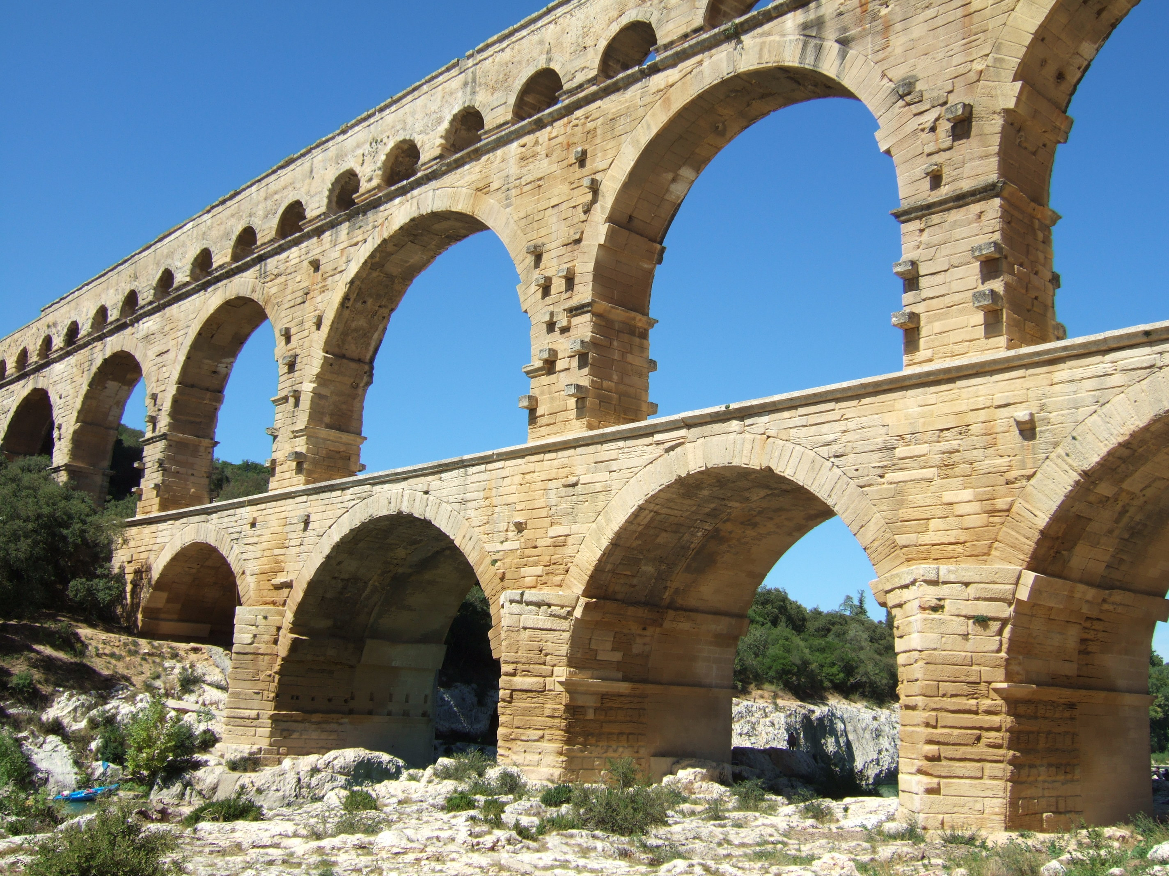
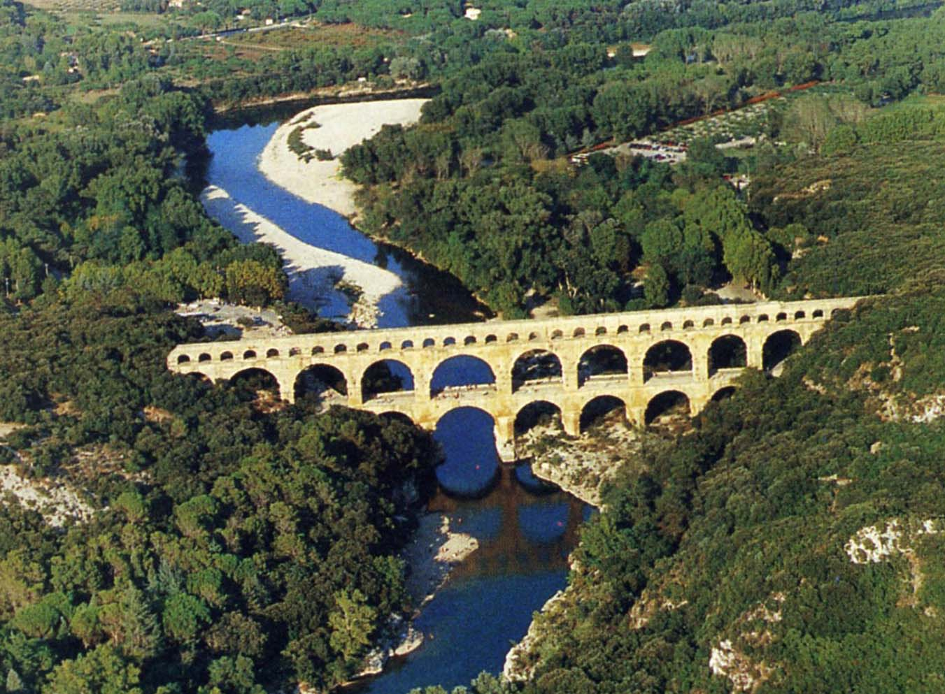
Pont du Gard

Slide 23
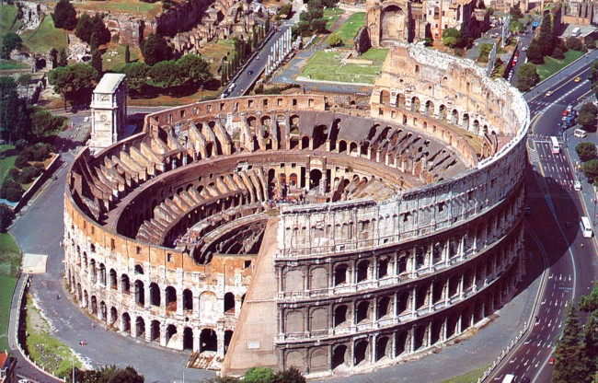
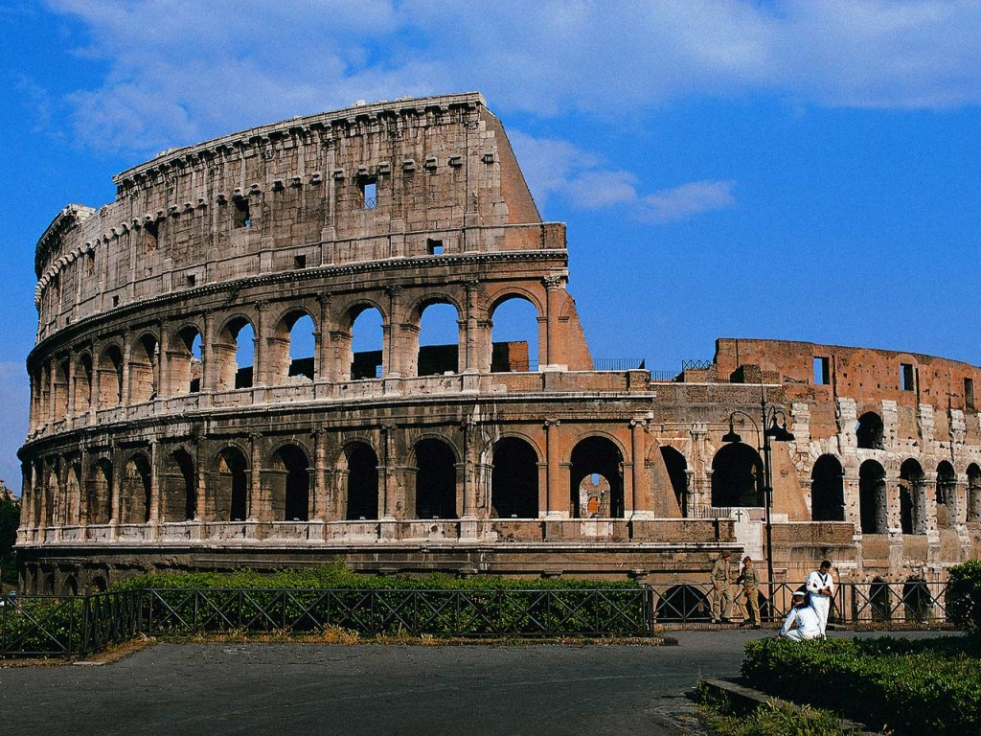
The Colosseum
The Colosseum covered six acres and accommodated 50,000 people, and is a reminder that Rome’s population exceeded one million. It was complete from 72-80CA- just 8 short years.
Roman amphitheaters like the Colosseum testify to the popular taste for entertainment such as chariot races, mock sea battles, gladiatorial contests, and a variety of brutal blood sports.
At the Colosseum, three levels of seating rose above the arena floor. Beneath the floor was a complex of rooms and tunnels from which athletes, gladiators, and wild animals emerged to entertain a cheering crowd.
To provide shade from the sun, an awning at the roof level could be extended by means of a system of pulleys.
The long-standing influence of this Roman amphitheater is apparent in the design of the modern sports arena. Name some modern arenas that are used for similar purposes!

Slide 24
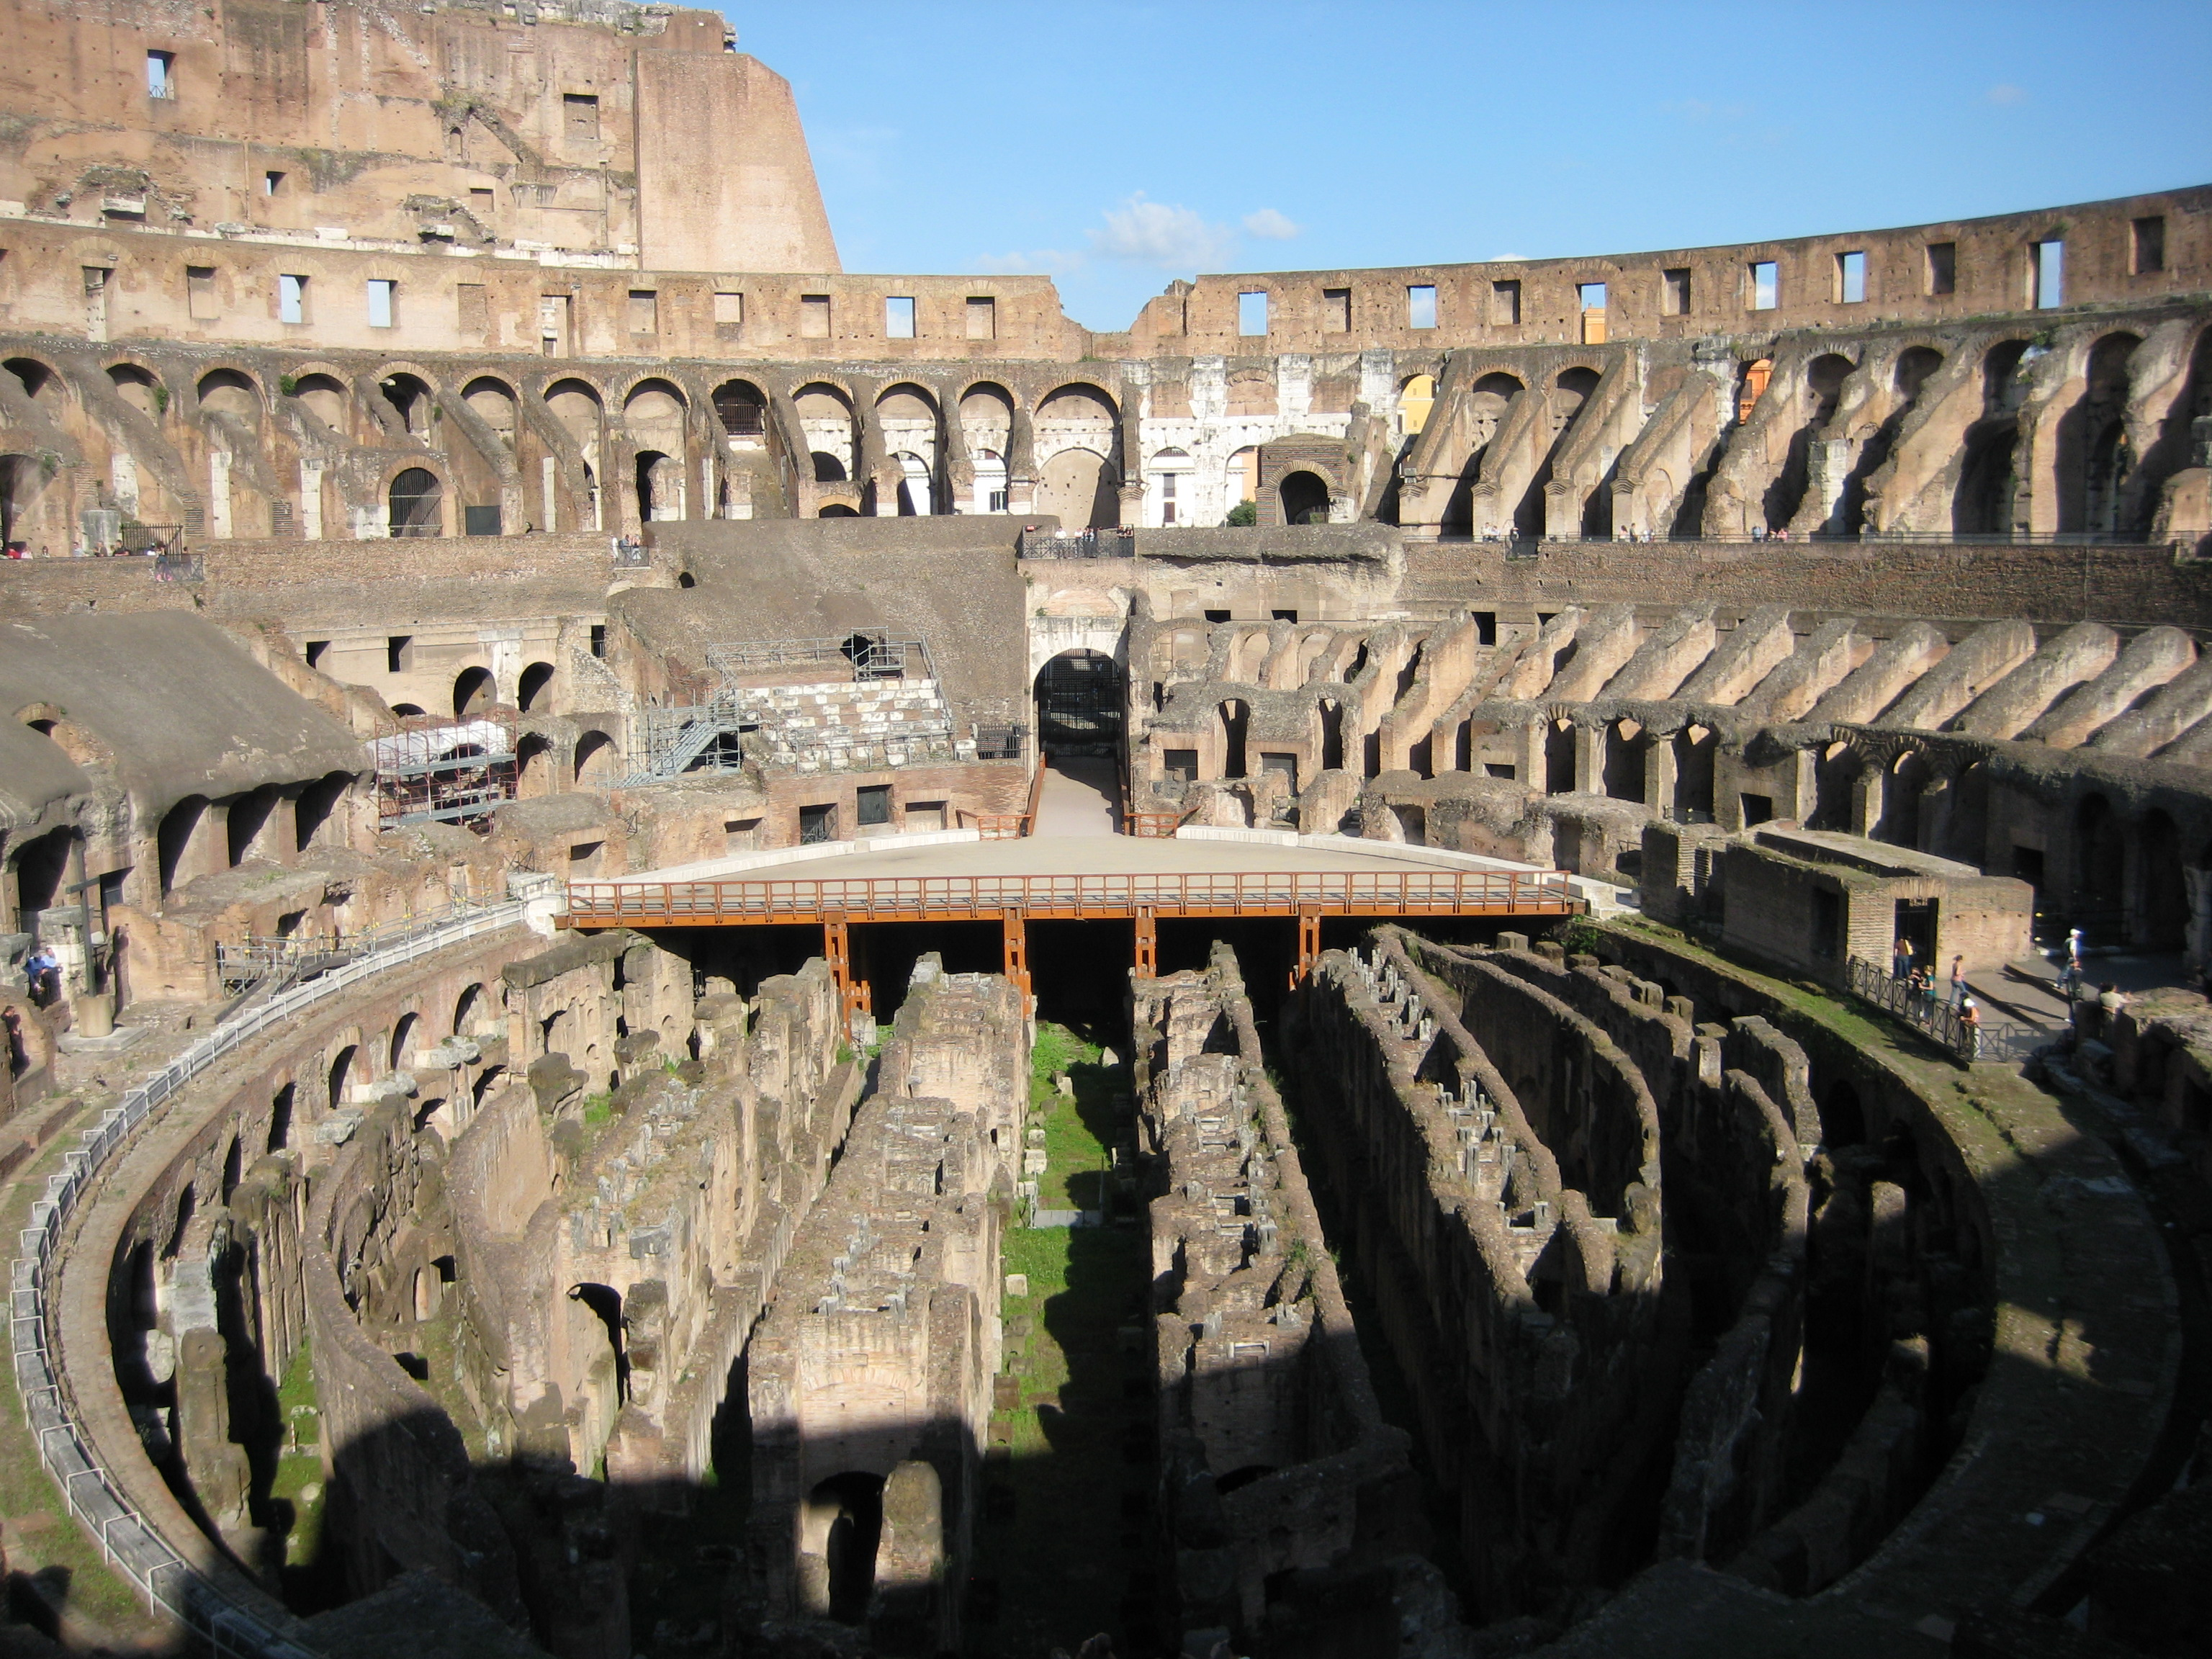

Slide 25
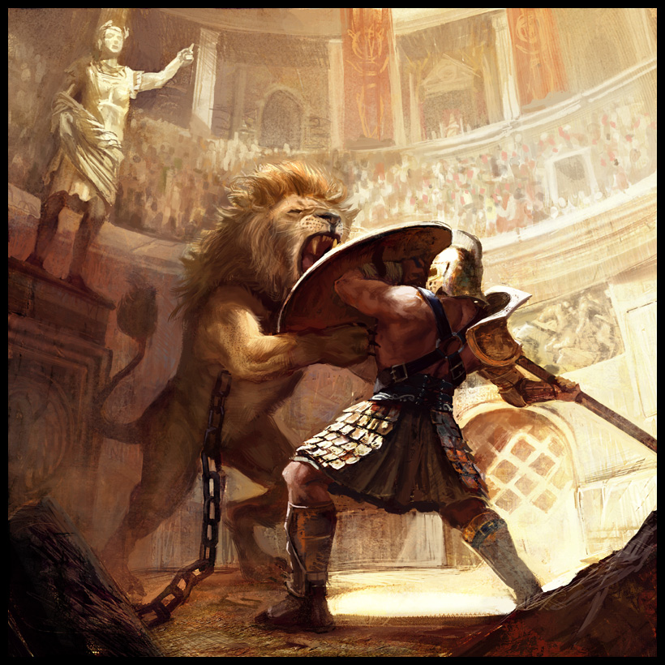
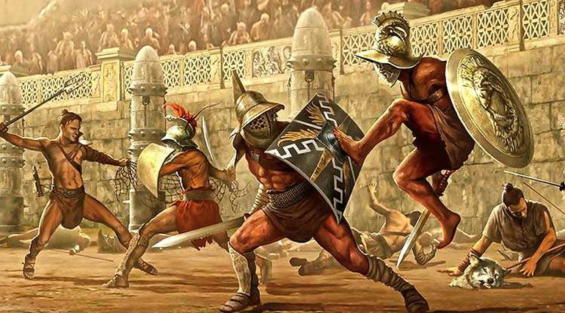
Roman Gladiators:
“Hail Emperor, those who are about to die salute you.” This is how the gladiators addressed their leader as they filed past the imperial box. Most gladiators were prisoners of war, slaves or criminals, sent through strict training schools.
The night before the gladiators are given a lavish banquet, where fans come to eye them like racehorses and pick and bet on their favorite.
The more unusual the contest the more the Roman’s like it. Gladiators often fought with mismatched weapons, dwarfs would fight women, Negroes were matched only with other Negroes. A superb fighter became a popular idol, and a gladiator who made a poor showing would be killed.

Slide 26
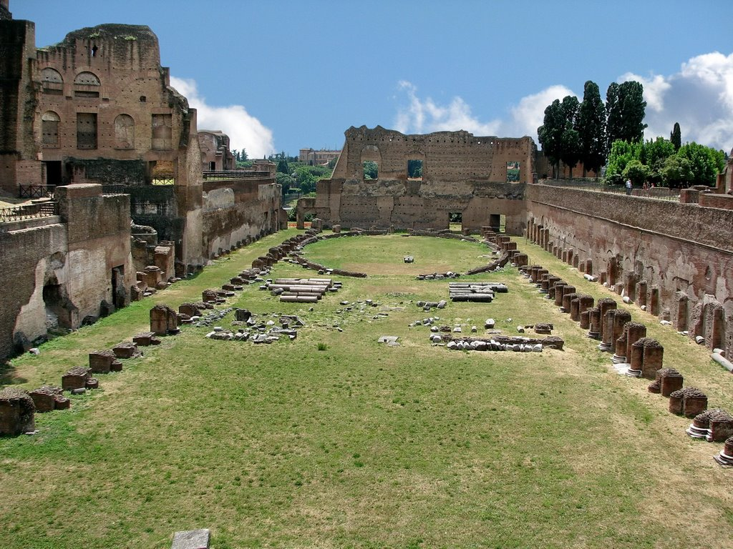
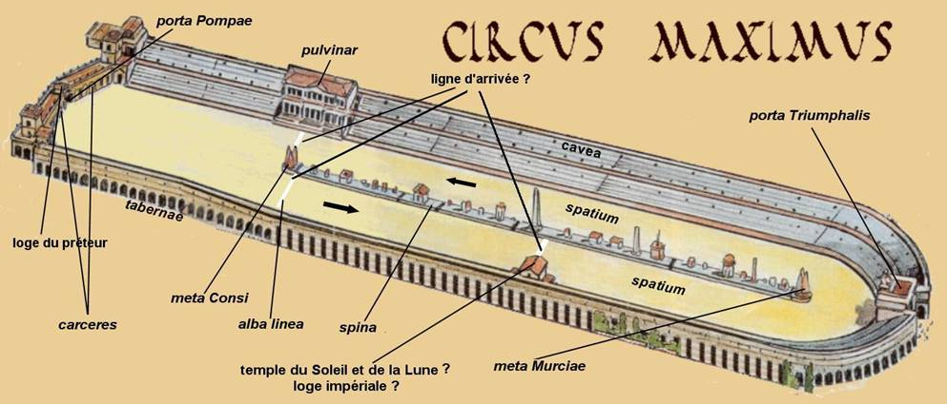
Circus Maximus:
In Rome's greatest amphitheater, the Circus Maximus, some 260,000 gathered to cheer daredevil charioteers as they raced around a perilously tight track. The brutal spectacles were usually staged by the government, and one of their chief purposes was to divert the menacing hordes of Roman unemployed, who at times numbered as many as 150,000.
Although Roman intellectuals were shocked by the carnage, the poor found the spectacles an outlet for passions that might otherwise have been turned against the state.
Great numbers of wild beasts fought and died in Roman arenas, often 5,000 animals in a single day. So many creatures were captured that whole species were sometimes threatened: the hippo in Nubia, the lion in Mesopotamia, and the elephant in North Africa.

Slide 27
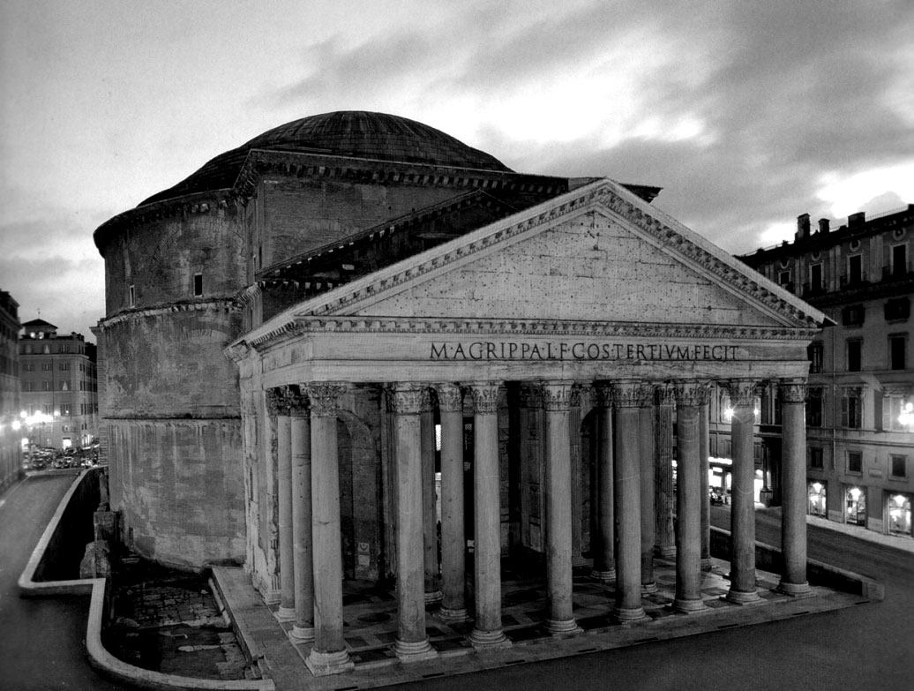
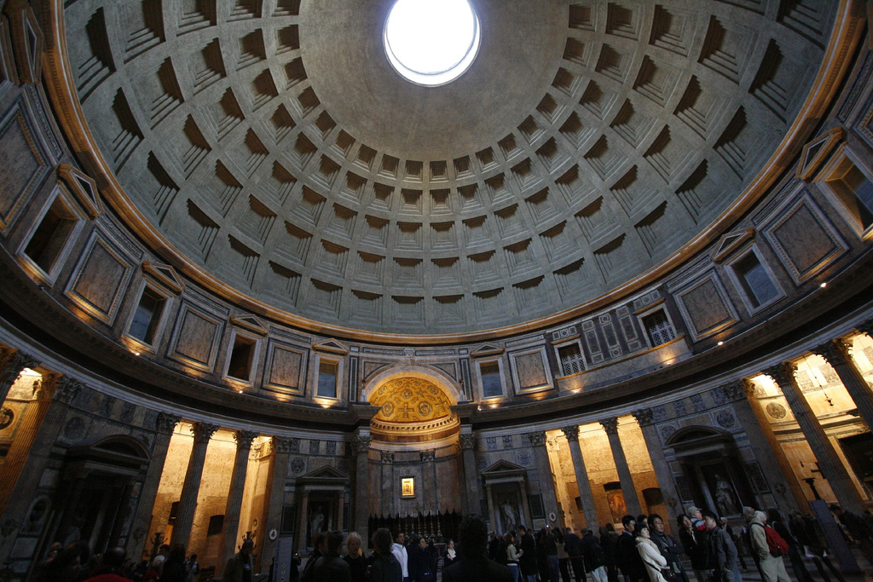
The Pantheon
Dedicated to the seven planetary deities, the Pantheon was built in the early second century C.E.
Its monumental exterior features a portico with eight Corinthian columns originally elevated by a flight of stairs that now lie buried beneath the city street.
One of the few buildings from Classic antiquity to have remained almost intact, the Pantheon boasts a 19-foot thick rotunda that is capped by a solid dome consisting of 5000 tons of concrete.
The interior of the Pantheon, once painted blue and gold to resemble the vault of heaven, is pierced by a 30-foot wide oculus, or “eye,” that admits light and air.
The proportions of the Pantheon observe the Classical principals of symmetry and harmony as described b y Vitruvius: the height from the floor to the apex of the dome, equals the diameter of the rotunda.

Slide 28
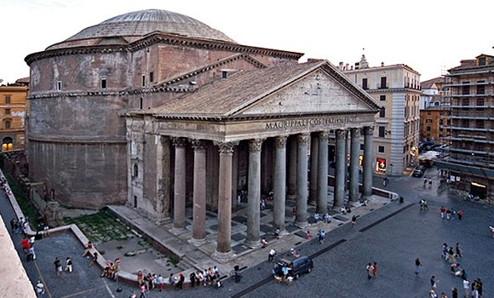
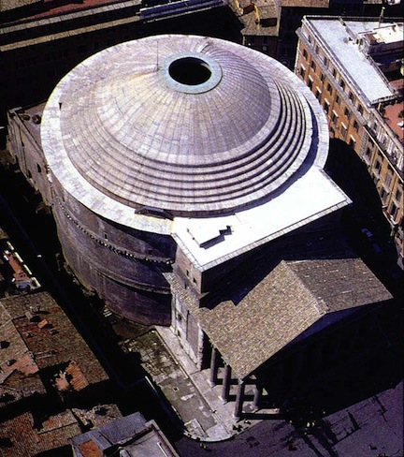
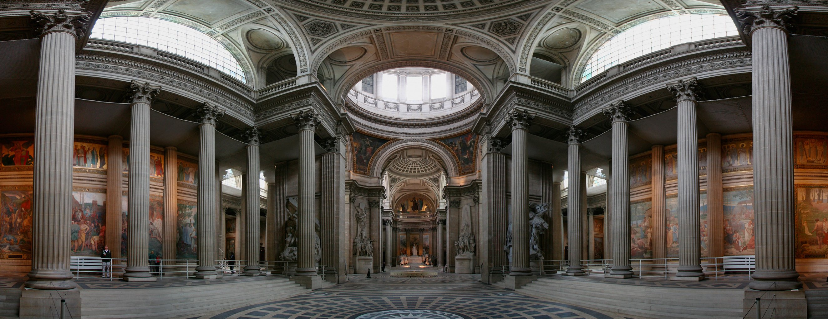

Slide 29
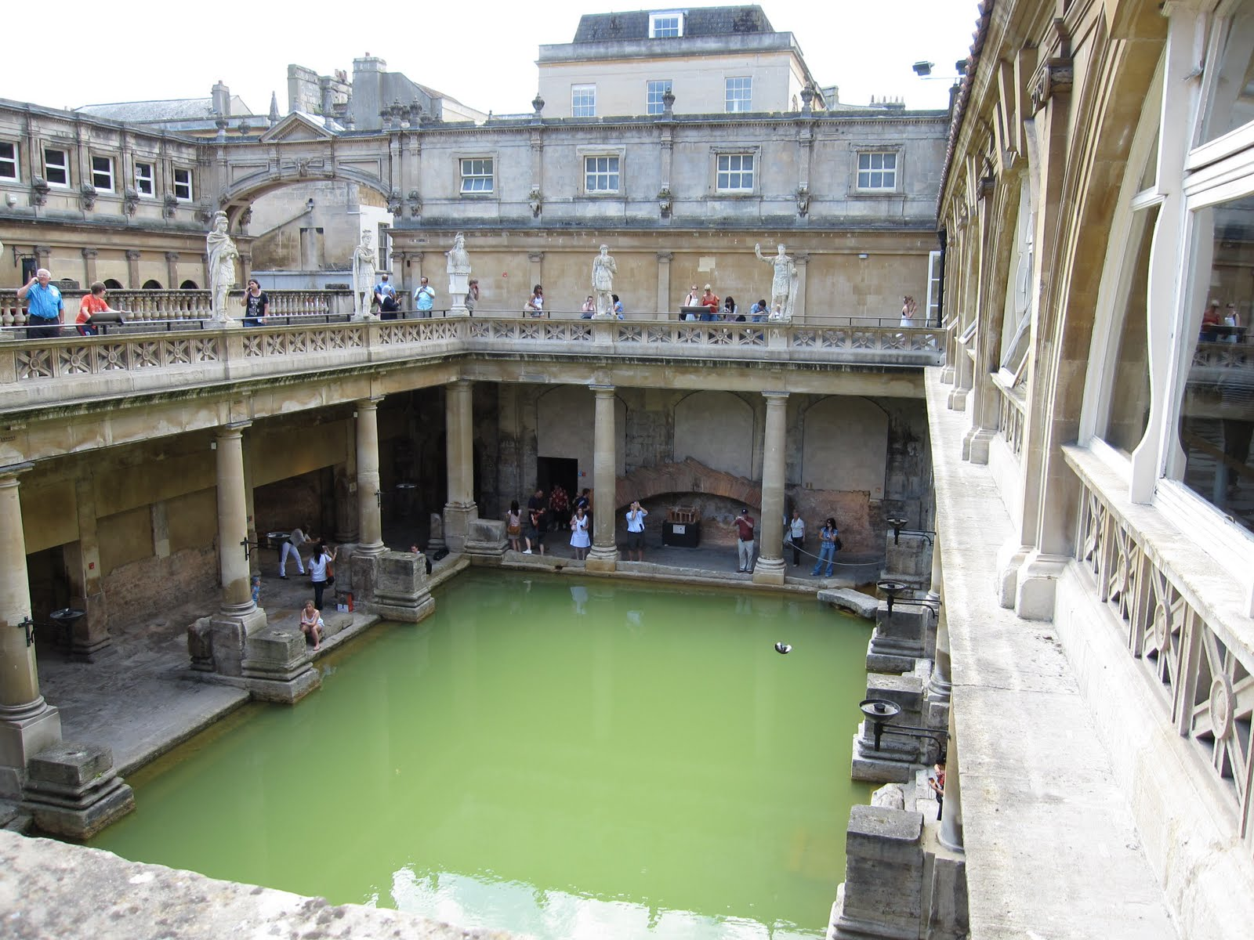
Roman Baths
The Roman baths were elaborate structures fed by natural hot springs, providing refuge from the noise and grime of the city. By the third century C.E., there were 900 baths in the city of Rome.
In addition to rooms in which pools of water were heated to varying degrees, such spas also included steam rooms, exercise rooms, art galleries, shops, cafes, reading rooms, and chambers for physical intimacy.
Roman baths incorporated the basilica, a rectangular colonnaded hall commonly used for public assemblies.
The Romans believed that good health came from bathing, eating, massages, and exercise. The baths, therefore, had all of these things in abundance. Since some citizens would be bathing multiple times a week, Roman society was surprisingly clean. Anyone have a favorite spa/hot springs experience?

Slide 30
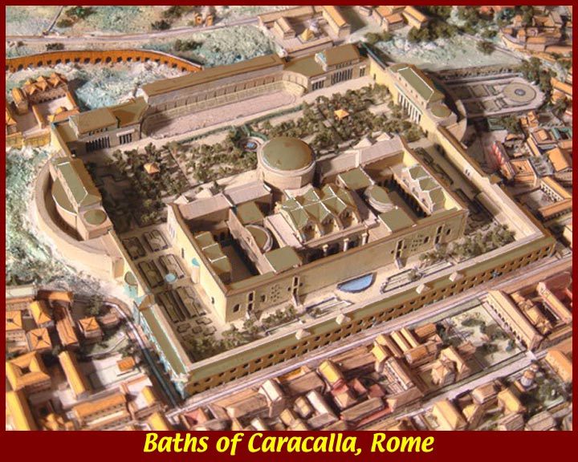
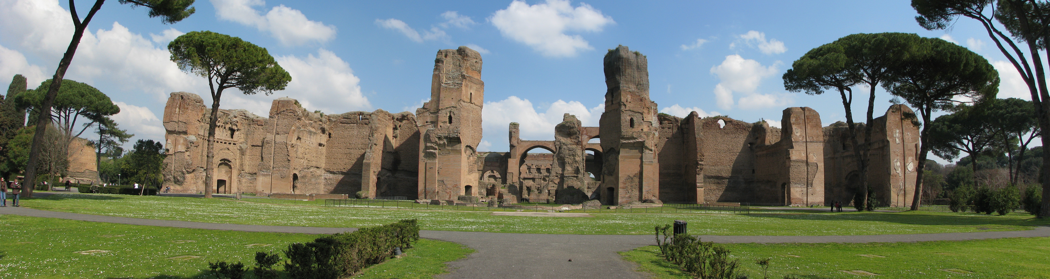
Emperor Caracalla’s Baths:
Constructed by Emperor Caracalla, these baths were a center of Roman life and one of the greatest engineering triumphs of the Third Century A.D. Sprawled upon 33 acres on Rome’s outskirts, the baths were a vast complex of businesses and entertainment establishments.
Aqueducts fed thousands of gallons of mountain water into the system, with the baths being heated by wood-burning furnaces connected to a network of steam pipes beneath the floors.
The grounds were decorated with gardens, colonnaded walks and statuary, an accommodated about 1,600 bathers per day.

Slide 31
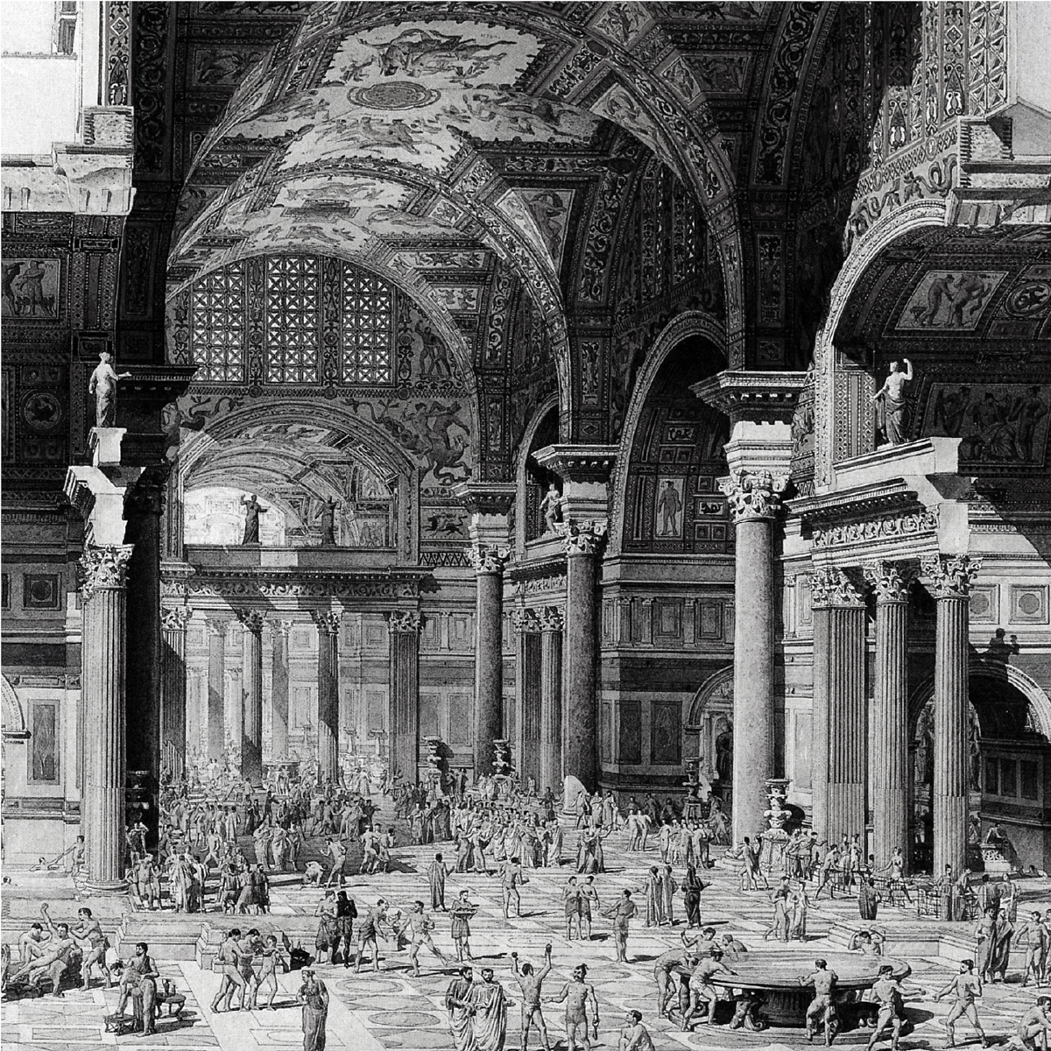
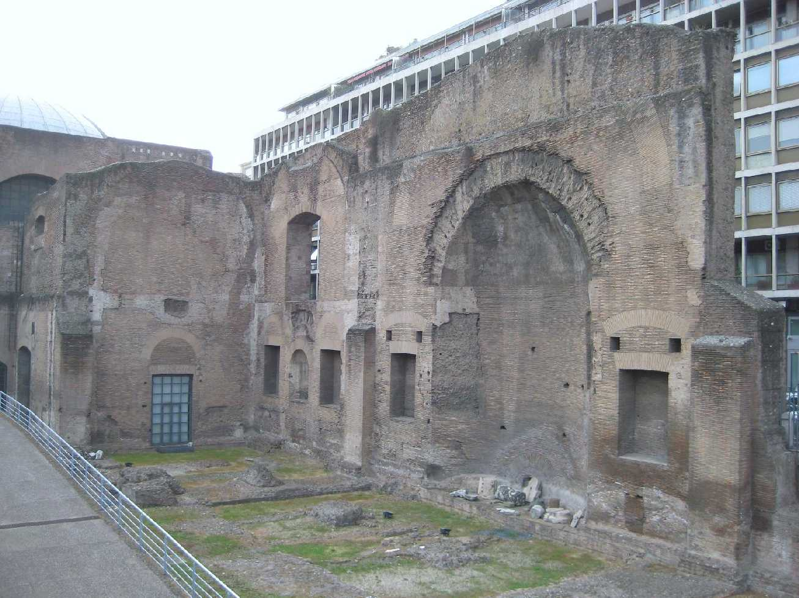
Diocletian’s Roman Baths

Slide 32
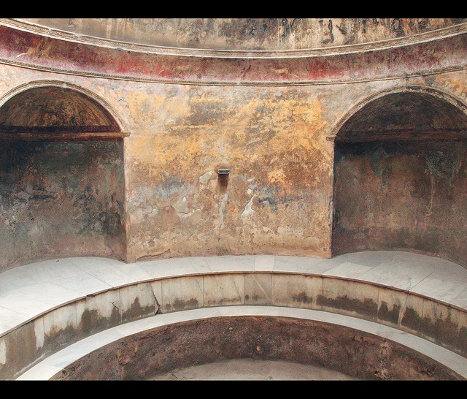
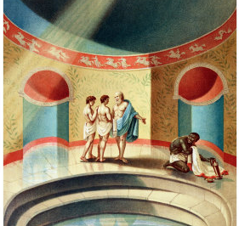

Slide 33
Roman Sculpture
Like its imperialistic predecessors, Rome advertised its military achievements in monumental works of art, consisting of mainly triumphal arches and victory columns, commemorating the victories of strong rulers.
Trajan’s Victory Column, made out of marble and standing 100 feet tall, includes 2500 figures presented as a huge picture scroll carved in brilliant low relief, and stood between the Greek and Roman libraries in ancient times.
The triumphal arch was the landmark image of Roman imperial victory, and served as visual propaganda. The arch of Titus, commemorates the final days of the Jewish Wars. The marble-faced concrete vault of the arch is elevated between two massive piers, and an attic, or superstructure carrying a commemorative inscription.
During the second century C.E., the tradition of heroic portraiture assumed an even more domineering stamp in the image of a ruler on horseback: the equestrian statue. The equestrian portrait of Roman emperor Marcus Aurelius depicts the general addressing his troops with the traditional gesture of imperial authority.

Slide 34
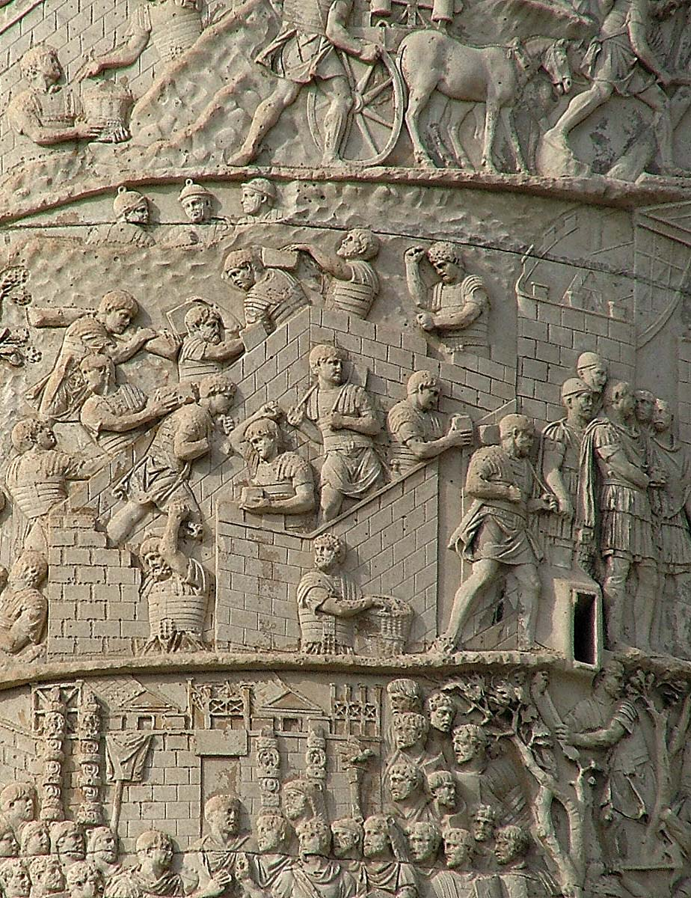
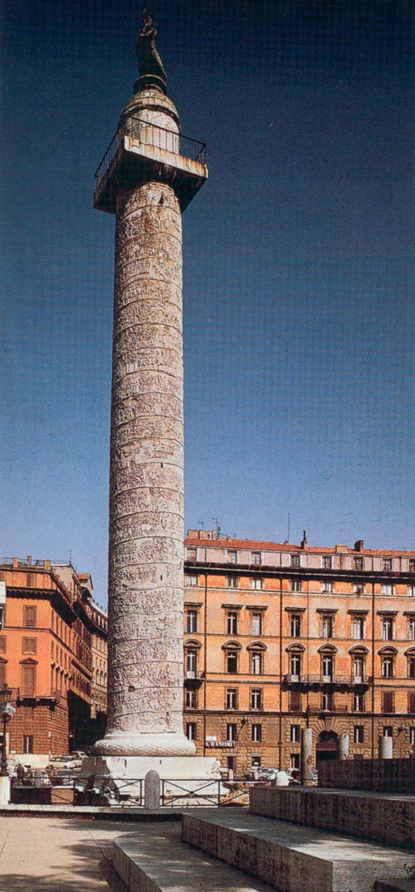
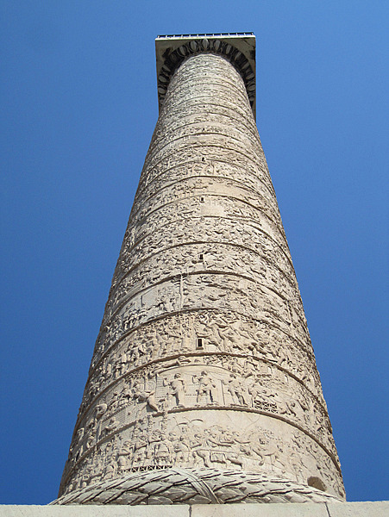
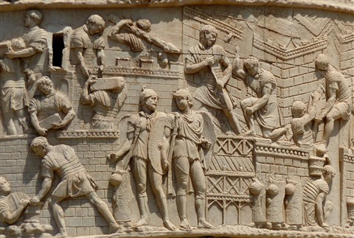

Slide 35
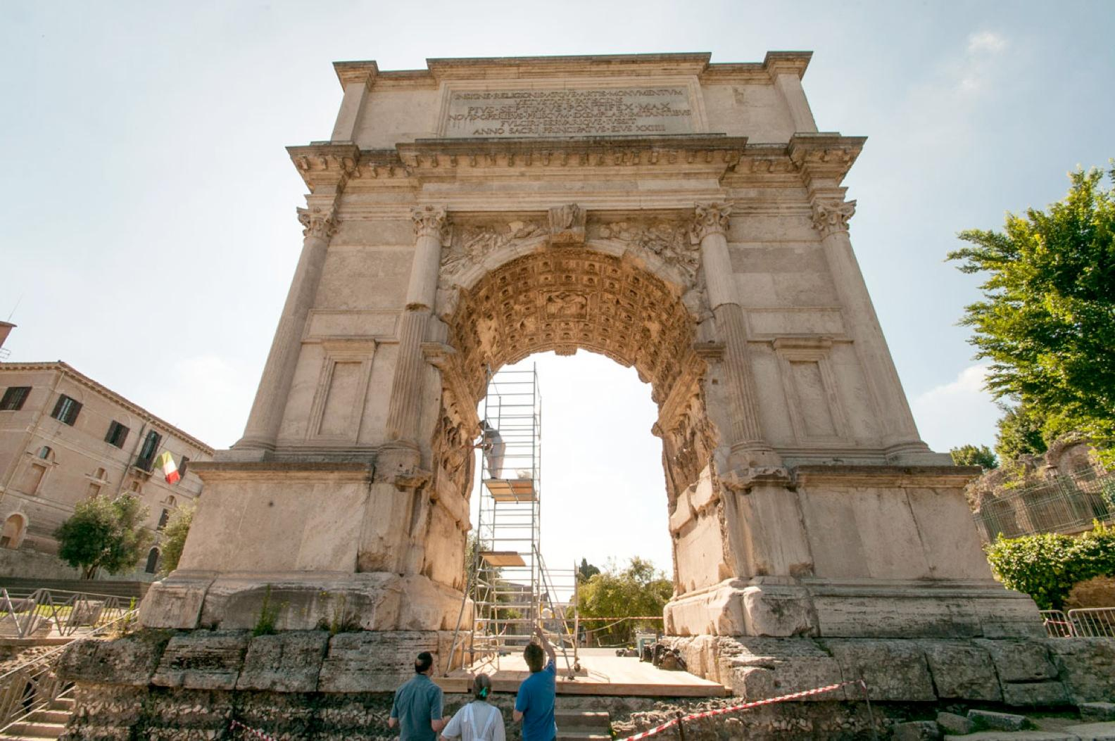
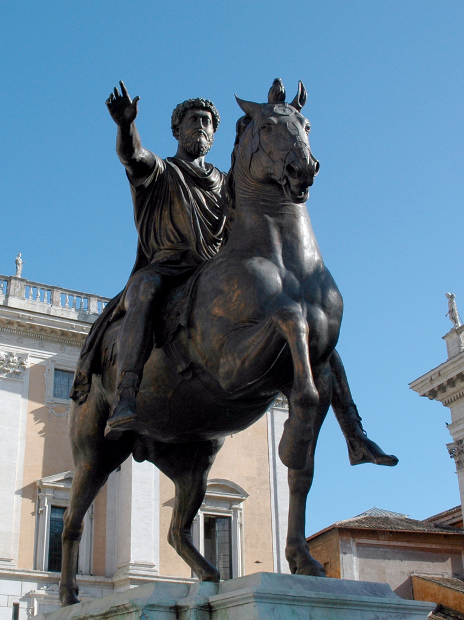
The Arch of Titus
Equestrian Statue of Marcus Aurelius

Slide 36
Roman Painting
Pictorial realism dominated the frescos with which the Romans decorated their meeting halls, baths, and country villas. Possibly inspired by Greek murals, Roman artists painted scenes drawn from literature, mythology, and daily life.
Among the finest examples of Roman frescos are found in and around Pompeii and Herculaneum, two cities that were engulfed by a mountain of ash from the volcanic eruption of Mount Vesuvius in 79 C.E., preserving many of the area’s suburban homes.
At a villa in Boscoreale, near Pompeii, floors and walls display fine, ornamental motifs and scenes illustrated in mosaic, a technique by which small pieces of stone or glass are embedded into wet cement surfaces.
The natural landscape as another subject reflects Rome’s attachment to the world of the senses. Although the Egyptians and Greeks both used natural settings, it was the Romans who pioneered landscape as a subject in and of itself. Roman landscapes show a deep affection for the country side and the pleasures of nature. The mountainous region of Arcadia provided the model for the Classical landscape, which celebrated a life of innocence and simplicity.

Slide 37
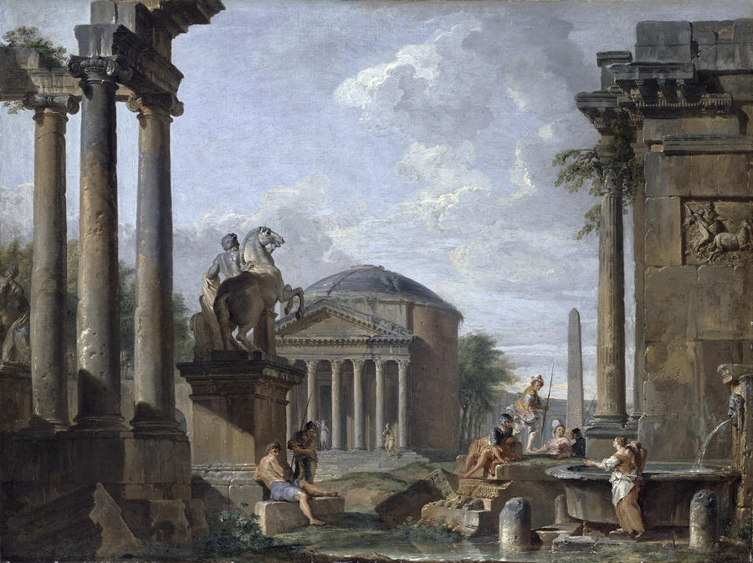

Roman Landscape Painting, The Odyssey Landscapes

Slide 38


Roman Mosaic

Slide 39


The Nile Mosaics, 100 B.C.E.

Slide 40


Pompeii- The eruption of 79 C.E., August 24th , 1:00p.m., with the force of the blast equaling two atomic bombs.

Slide 41




The eruption of Mt. Vesuvius killed more than 16,000 people, most being buried under 4 to 6 meters of volcanic ash an d pumice.

Slide 42





Slide 43

What do you see in the streets?
Why do the streets run uphill?
What are the large stones in the middle of the street for?

Slide 44


The Forum at Pompeii:
The commercial and administrative center of town.
Mount Vesuvius lies in the background. She still erupts about once every 35 years, the last major eruption being in 1944.
Vesuvius is considered one of the most dangerous active volcanos due to the 3,000,000 people who live near it.

Slide 45


Amphitheater of Pompeii
The forum at Pompeii is the oldest of its kind, erected in 70 B.C.E.
The amphitheater is sunk into the ground so that the arena and lower tiers are below ground level.
The amphitheater measures 444 feet long by 342 feet wide, and had space for up to 20,000 spectators.
The attraction of the arena consisted of gladiatorial games (and training), and animal baiting where spectators came to see combatants killed.

Slide 46





Slide 47
Roman Inventions:
Concrete: The fact that Roman structures like the Colosseum are still standing are due to the use of an early form of cement, created from a recipe of slacked lime and volcanic ash to form a sticky paste that was then mixed with volcanic rock.
Welfare: Government programs that provided subsidized food, education, and other expenses for the less well-off can be traced to ancient Rome.
Bound Books: Prior to the Roman Empire, literature took the form of clay tablets and scrolls. Romans streamlined this medium by creating the codex, or stack of bound pages, bound by animal skin parchment.
Sewers: In Rome there were seven major sewer systems running out of the city. These sewers can still be found under the city today.
Field Surgery: Along with developing new surgical tools and pioneering the method of cesarean section, Rome established military medial corps, where soldiers could be treated on the field of combat.
Newspapers: Romans inscribed texts dealing with military, legal, and civil issues, and made them accessible to the public. Known as “Daily Acts,” these early newspapers included birth and death notices, results of gladiatorial bouts, and military victories. They were posted in heavily populated areas.

Slide 48




Roman Weapons and Military:

Slide 49
The Fall of Rome
Why and how the Roman Empire came to collapse in the fifth century C.E., has intrigued scholars for centuries. A great many theories have been investigated, ranging from soil exhaustion and lead poisoning to the malaria epidemic of the third century. It is likely no one problem was responsible. This was exacerbated by Emperor Constantine moving the heart of the Roman political empire to Constantinople in 324CA, after declaring Christianity legal through the Edict of Milan in 313CA.
In reality, it was probably a result of a combination of internal circumstances: the difficulty of governing so huge an empire, the decline of the slave trade, and the increasing gap between the rich and the poor. (During the height of he empire, one-third to one-half of Rome’s urban population received some sort of welfare).
Finally, in 476, a Germanic army commander led a successful attack on Rome, however, Pope Leo I negotiated successfully with Attila the Hun, who withdrew, leaving a continued power vacuum that only the Roman Catholic church would be able to fill.

Slide 50










Making Connections:

Slide 51






Making Connections:

Slide 52


Making Connections:

Slide 53
Chapter 6 Need To Know:
The Roman Republic was made up of patricians, the wealthy upper class who controlled the lawmaking process, and plebeians, the farmers, small landowners, and soldiers.
Julius Caesar laid out the Forum, Rome's first meeting place, reformed the Western calendar to reflect 365 days per year, and twelve months, and he was the first historical Roman to be deified by the Roman Senate.
Virgil’s epic literary work, The Aeneid, would become the foundation for education in the Latin language.
The Roman innovation of the arch in their architecture allowed the structure to enclose great volumes of space, and was a clear advance over the Greek post-and-lintel construction.
Two artistic innovations brought forth by the Roman are landscape painting and mosaics.
Ultimately, the fall of Rome was due to four factors: the large separation between rich and poor people, corruption amongst the Roman administration and clergy, the arrival of the prophet Jesus, and the relocation of the Roman Empire by Constantine from Rome to Constantinople.

